Slide 1





DA_P819 Insurance Project
A BI Capstone Project on Insurance Analytics

Slide 2
Group 3 Members
Harish S Timmapurkar
Gokul Rajan Pillai
Gautam Hansan
Saurabh Wakode
Pranav . S
Muhammed Faiz Ahmed

Slide 3
Project Overview
Project Overview: The Insurance Project aimed to create interactive and insightful dashboards using Advanced Excel, Tableau, Power BI, and SQL. The goal was to analyze various aspects of insurance data, including brokerage, fees, budgets, invoices, meetings, opportunities, and policy data. By integrating and visualizing this data, the project provided stakeholders with valuable insights for decision-making.
Key Objectives:
Develop interactive dashboards for financial analysis
Ensure data accuracy and consistency across different sources
Provide insights on revenue, brokerage trends, and profitability
Enable efficient drill-through navigation for in-depth analysis
Optimize dashboard performance across multiple platforms

Slide 4
Challenges Faced
Slow dashboard performance due to large datasets.
Handling multiple sheets in Advanced Excel and Tableau can become sluggish.
Errors in calculated fields affecting reports.
Understanding which key metrics matter the most for insurance reporting.
Ensuring consistency across Advanced Excel, Tableau, Power BI, and SQL.
Inconsistent data formats across different files
Difficulty in merging multiple datasets
Selecting appropriate visualizations for clear data representation
Interpreting complex financial data
Lack of proper documentation making it hard to understand business logic

Slide 5
Strategic Recommendations
Validate calculations using smaller datasets before full-scale implementation.
Implement data validation rules before importing data.
Reduce data model size, use aggregations, and apply efficient DAX calculations.
Work closely with Instructors and group members to align KPIs with desired objectives.
Use clear annotations, tooltips, and breakdown analysis for better understanding.
Follow best practices like using bar charts for comparisons.
Conclusion: Addressing these challenges required continuous data validation, tool optimization, and effective team communication. By implementing the above strategies, the project ensured accurate and insightful dashboards that facilitated better decision-making in the insurance sector.

Slide 6
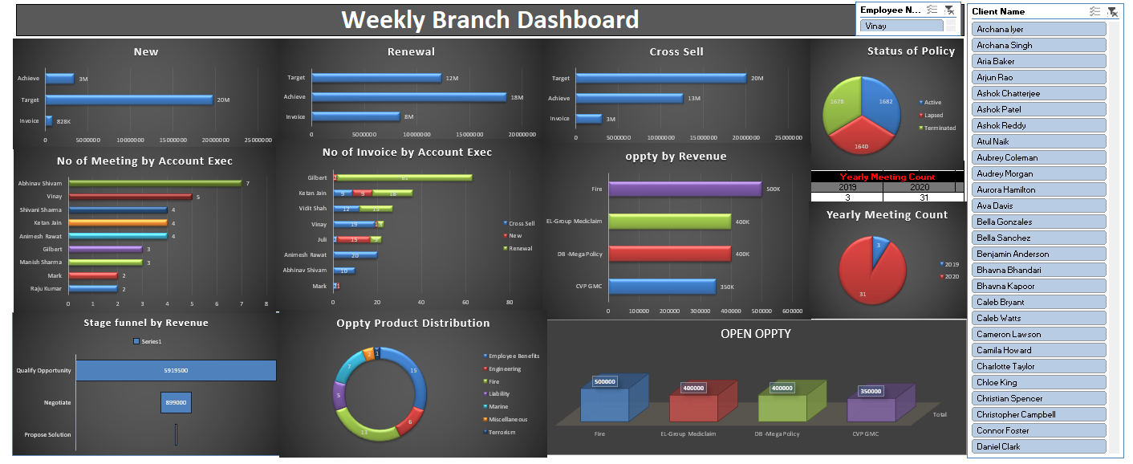
Excel Insurance Dashboard

Slide 7
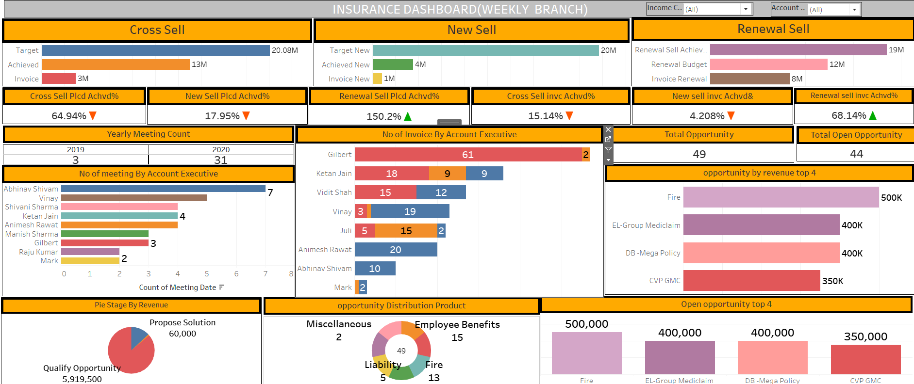
Tableau Insurance Dashboard

Slide 8
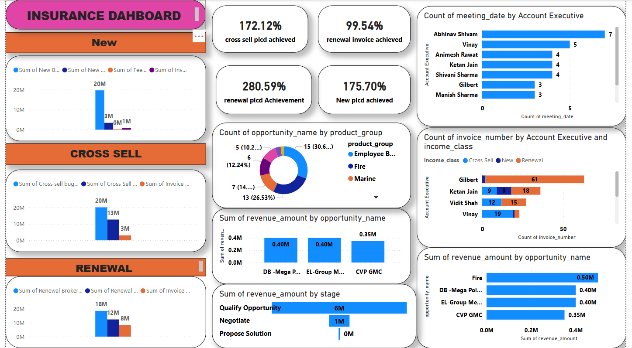
Power BI Insurance Dashboard

Slide 9
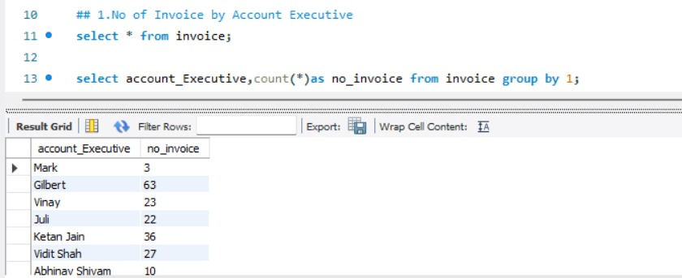
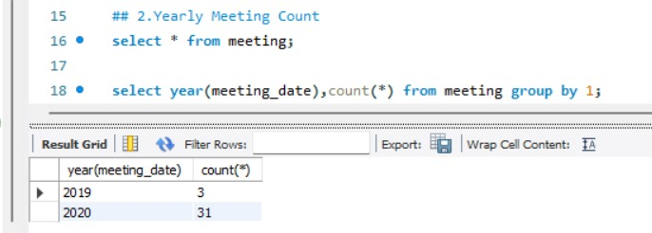
SQL

Slide 10
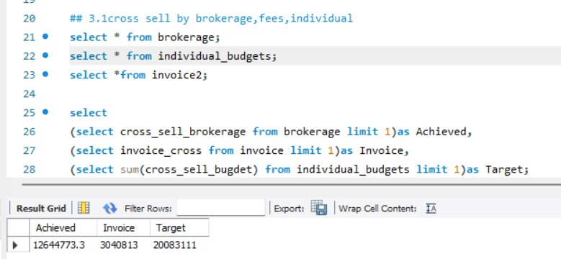
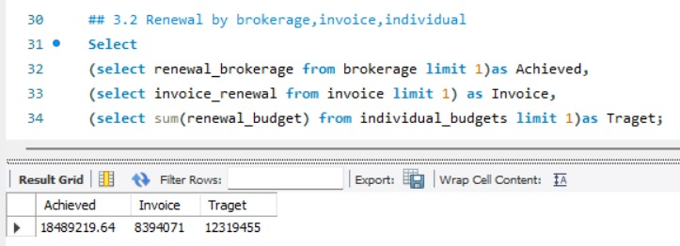
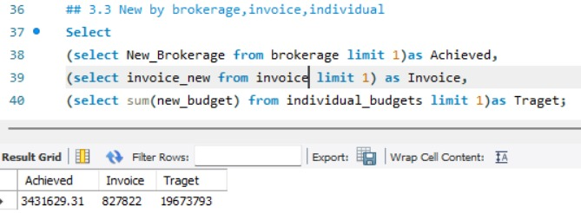
SQL

Slide 11
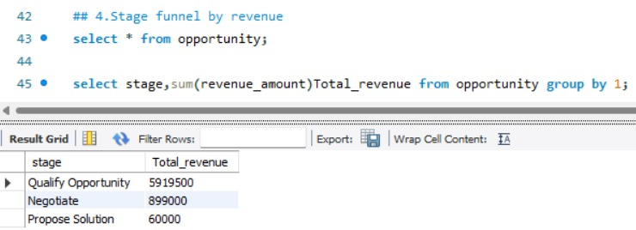
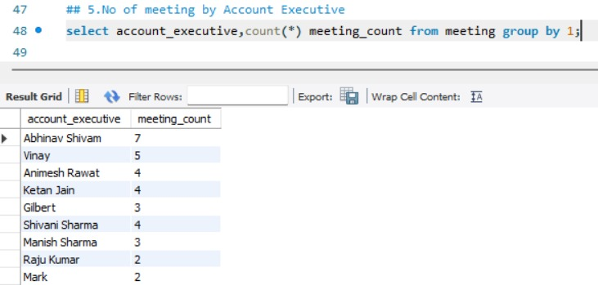
SQL

Slide 12
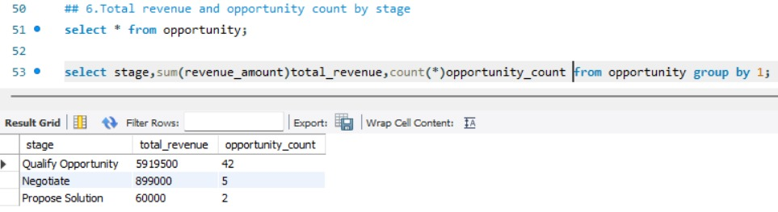
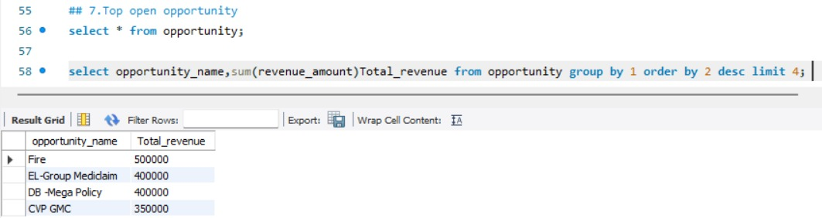
SQL

Slide 13
THANK YOU

